Slide 1
BlockChain

Slide 2
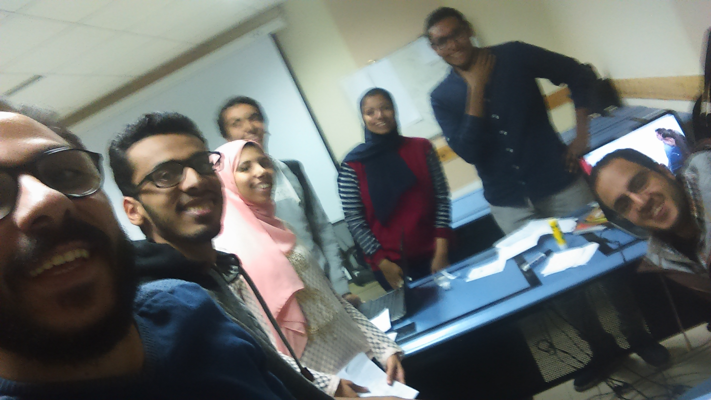
HELLO!
We are WolfPack Team
We are here to Talk to you about BlockChain in some details, its applications and its cons.

Slide 3
1.
What is BlockChain?
Let’s start

Slide 4
1991
History
Satoshi Nakamoto
4

Slide 5
Types
Private
Public
Consortium
5

Slide 6
2.
How does BlockChain work?

Slide 7




Hash
Hash
NEW BLOCK
Hash
Hash
P Hash
P Hash
P Hash
DATA
DATA
DATA
DATA
Hash
Hash
Hash
Hash
Hash
P Hash
DATA
P Hash
P Hash
P Hash
DATA
DATA
DATA
DATA
Hash
Hash
Hash
Hash
P Hash
P Hash
P Hash
P Hash
DATA
DATA
DATA
DATA
Hash
Hash
Hash
Hash
DATA
P Hash
DATA
P Hash
P Hash
P Hash
DATA
DATA

Slide 8
3.
BlockChain Applications!

Slide 9

Cryptocurrencies
9
9

Slide 10

10

Slide 11

Smart Contracts!
11

Slide 12
4.
Why BlockChain?

Slide 13


Distributed
13

Slide 14

Stability
14

Slide 15

Trustless System
15

Slide 16
5.
BlockChain & Software Engineering

Slide 17
6.
BlockChain CONS!

Slide 18


Data Modification
18

Slide 19

Storage
19

Slide 20

Private Keys
20

Slide 21


7.
Activity!

Slide 22
7*3+57%10-10/5

Slide 23
THANKS!
Any questions?

